Slide 1
President’s Diversity, Equity, and Inclusion Task Force Town Hall
Dialogue and Allyship
Notes:
Vicka talking

Slide 2
Subcommittee Members
Nobia Hailu, Sophomore Biochemistry student
Bennyce Hamilton, Regional Director of Diversity/Deputy Title IX Coordinator
DeUnna Hendrix, Head Women’s Basketball Coach
Natalee Price, Clinical Psychology PhD student
Valerie Robinson, Assistant Dean, The Graduate School
Jon Simon, University Communications & Marketing
Tarah Trueblood, Director, Center for American & World Cultures (Chair)
Vicka Bell-Robinson, Director, Residence Life (Liaison)
Notes:
We know there is a desire for folks to talk. Difficult times.
Tarah invites each team to unblock mic and say Hi, self introduce.

Slide 3
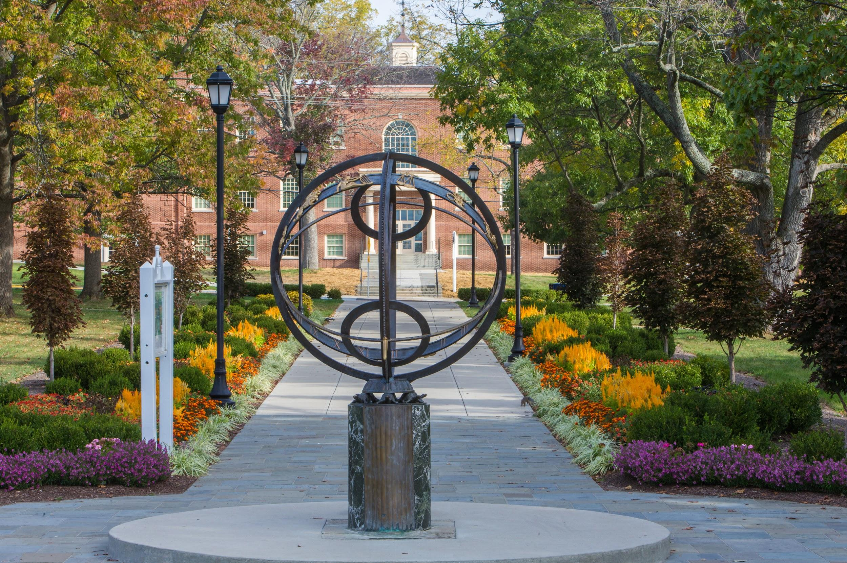
Agenda
Our Time Together
Discuss 2 Models for Dialogue
Explore What has Been Done and is Planned
Evaluations / Assessments
Big Picture Recommendations
Questions & Opportunity for Audience Engagement
Notes:
Tarah
prior questions: appreciated; most embedded into pres.
Add’l Qs: content relevant

Slide 4
Two Dialogue Models Identified in Charge
Inter-Collegiate Athletics (ICA)
Designed by and for ICA
Not designed for duplication
Good model for others
Facilitators available for consultation
Center for American & World Cultures (CAWC)
Easily duplicated & expanded to students, faculty, staff, alums.
Students: “Voices” Intergroup Dialogues (IDS 253 & 151), Intro to Voices (Experiential Learning Lab).
Faculty, Staff, Alums: Train-the-Trainer Model
CAWC provides training and support for co-facilitators
Co-facilitators recruited from prior participant cohorts.
Notes:
Dee & Tarah

Slide 5
ICA Dialogues & Town Halls
What is the ICA Model?
Overlapping, structured dialogues among athletes and coaches within a team
Overlapping Town Hall meetings focused on equity, diversity, and inclusion
Diversity & Inclusion Council works with RedHawk Council and Champions 4 Life Academy to plan and execute programming
Why is ICA’s Model Successful?
High level of commitment by senior leadership
High level of accountability within the team
Buy-in from students and coaches
A group of influencers from across campus who help champion the program and determine how collaboration might occur across teams.
Notes:
Dee

Slide 6
ICA Dialogues & Town Halls:
What We’re Planning (2020-21)
Town halls with coaches, staff, and student-athletes
Staff meetings to include bias training/workshops
S-A and staff education on allyship
Climate survey
Provide ongoing educational resources that bring awareness to inequities of oppressed groups
Provide mental/emotional health resources to all S-As
Notes:
Dee

Slide 7
CAWC’s Intergroup Dialogues (IGD)
IGD is a “Best Practice” in moving the needle on campus climate and preparing students for equitable leadership in a diverse global community & marketplace.
What is IGD?
Dialogue (not debate)
Sustained (minimum of 6-8 weeks)
Small group of individuals across social identities (12-20 people)
Peer co-facilitated
Activities and dialogues
Explores existing intergroup conflict and allyship
Group Action Project (students) or Capstone (faculty/staff)
Challenges
Burden
Willingness
Model of change
Initial Outcomes
IGD presents a “rare opportunity” for Miami students to interact in ways that illuminate lived experiences of both privileged and marginalized groups.
All participants gained non-judgmental listening skills and insight into complexity around social identities.
Privileged groups had greater gains in some areas.
Notes:
Natalee

Slide 8
CAWC’s IGD: Done and Planned
What We’ve Done (2018-Present)
Students: 3 Semesters (13 cohorts)
Voices of Discovery (VOD): Courses IDS 151 and 253)
Intro to Voices (ITV): Co-curricular program
New Global Readiness Certificate requires IDS 253
Faculty & Staff (3 cohorts)
IGD Faculty Learning Community (2019-20)
CCES: 2 cohorts (spring 2020)
CTE: Workshops with IGD components (various)
What We’re Planning (2020-21)
Students:
IDS 151 (1 credit) (1 cohort/semester)
IDS 253 (3 credits) (1 cohort/semester)
ITV (4 cohorts/semester)
Faculty & Staff:
Faculty & Unclassified Staff (4 cohorts)
Classified Staff (1-2 cohorts)
FSB Faculty (1-2 cohorts)
Notes:
Students -- Tarah (both sides of slide)
Faculty & Staff -- Valerie & Bennyce (both sides of slide)

Slide 9
Evaluation of CAWC’s IGDs
Student Cohorts
Discovery Center/Michigan Cohort Tool
Overarching: “Voices continues to presents a rare opportunity for students from BOTH privileged and oppressed identities to interact in ways that illuminate the lived experiences of both groups.”
Strongest Overall Gains (Spring 2020)
MU Marketing Students
Action: Allyship
Awareness of structural racism
Social identity engagement
Other Majors Students
Skills in dealing with conflict
Action: Allyship
Increased involvement in social justice
Faculty/Staff Cohorts
Center for Career Exploration & Success:
Staff facilitators report that the facilitation training was very impactful and continues to be referenced often in ongoing conversations about DEI and belonging.
Therefore I would highly recommend the train-the-trainer model. This model has a balance of education and prescriptive direction that provides a path forward for those who may be newer to IDG and facilitation in general. --Tekeia Howard, Assoc. Dir.
2019-20 Faculty Learning Community in IGD:
Strongly recommends scaling IGD for all Miami faculty and staff adapting a model implemented at Northwestern University.
Notes:
Students: Tarah
Faculty/Staff: Bennyce & Valerie (also, if comfortable, give brief personal testimony of your experience of IGD from last year’s FLC. Do you recommend? Why?

Slide 10
“Big Picture” Recommendations / Q & A
1. Expand IGD to more students
Embed IGD as an experiential learning lab into UNV 101.
Create a new IGD minor or certificate to secure a pipeline of peer facilitators.
Include IGD as component in leadership certificates (Wilks, etc.)
Require all RAs and students in certain living/learning communities (LLC) to take IGD.
Create a new LLC to train student peer facilitators.
Empower students to host Town Hall “dialogues” on Hot DEI Topics.
2. Expand IGD to more faculty/staff
Use the train-the-trainer model to expand IGD to 50% of Miami faculty/staff.
Encourage college chairs to recognize IGD as a form of campus service.
Recognize IGD as “professional development” for staff.
3. Expand IGD Beyond the Campus
Expand IGD to include alums.
Expand IGD to business and community members (fee-based).
Notes:
Valerie

