Slide 1
President’s Diversity, Equity, and Inclusion Task Force Town Hall
Inclusion and Accountability

Slide 2
Agenda
Our Time Together
Introductions
Explanation of Pillar via the President’s Charge
Subcommittee’s Interpretation and Discussions
Preview of 6 Recommendations
Opportunity for Audience Engagement
Notes:
(Mark) I think we want to highlight here, that we are going to try and be brief with our agenda to allow time for questioning because we understand that is the only way we can be challenged and only way to challenge our thinking and our purpose as a task force.

Slide 3
Sub-committee Members
Chair
Mark Taylor - Chief Procurement Officer, Office of Strategic Procurement
Liaison
Dr. Anthony James - Associate Professor, Family Science & Social Work
Members
Enoch Carlstrom - Assistant Director, Office of Community Standards
Elias Tzoc - Department Head, University Libraries
Tristen Hall - Doctoral Student, Student Affairs in Higher Education
Sarah Matthews - Data Analyst, Enrollment Management and Student Success
Notes:
(Mark) Please add your title!

Slide 4
Inclusion and Accountability - Charge
Miami has completed reports, surveys, projects on DEI efforts
How do we continually update, assess, and hold everyone accountable for the efforts and outcomes?
We must explore recruitment, hiring, retention, and promotion actions for underrepresented groups.
Notes:
(Mark) Slide on Explanation of Pillar via the President’s Charge
Presented by Mark Taylor

Slide 5
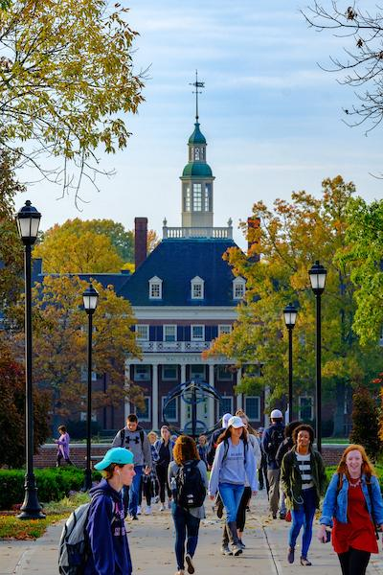
Inclusion and Accountability - Early Discussions
Identify key units/offices that will help implement recommendations
Recommendations include input from two undergrad students
Real change will require effort, commitment, and accountability
Communication and transparency with DEI initiatives/processes
Notes:
(Mark) Slide on Subcommittee’s Interpretation and Discussions
Presented by Mark Taylor

Slide 6
Preview of Recommendations
Recommended Timeline
Comprehensive diverse ally/mentor program for new hires and staff
Sept. 2020
Create a centralized system that brings awareness and disseminates DEI initiatives
June 2021
Implement a “behind the scenes” forum. This would be a generalization of what their process looks like from an accountability standpoint. (OEEO, OCS, OGC, HR, AP etc.)
Sept. 2020
Notes:
Slide on Committee's current recommendations (1-3) Mark introduces the recommendations and will share about
1. (Mark)
2. (Elias)
3. (Enoch) Create a program or town hall that speaks to their process and helps students, faculty, staff to understand what it looks like when a student reports a racist comment made by faculty, by a student, by a staff, by a community member. Walk us through generalizations of what the process looks like; be more transparent as student’s aren’t aware of what is taking place behind the scenes. We don’t have to provide details for specific cases, but can generalize what is happening in the process and with the office.

Slide 7
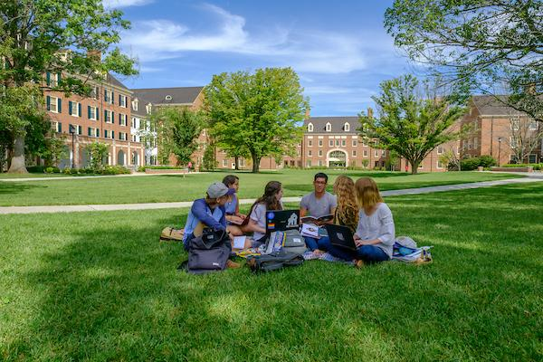
Preview of Recommendations 2
Recommended Timeline
Provide clarity around what MU has to offer in terms of DEI in the curriculum (Global Miami Plan)
TBD
Utilize students' retention, graduation, and success rates to drive accountability
Dec. 2020
Enhance transparency and accountability for bias report system (Submitting reports anonymously)
Sept. 2020
Notes:
Slide on Committee's current recommendations (4-6)
Where are we as a university falling short in supporting our students of underrepresented groups at Miami, what does this mean as a division, as program staff, what do we need to change and implement to see these students improve (not numbers)
4. (Tristen) Provide clarity around DEI curriculum-- which classes are considered to center DEI curriculum,decisions on what students should be required to take include… there are elements of this recommendation that can be started on sooner, global miami plan is currently under review so as they are working on that we submit this recommendation for their current reviews.
5. (Sarah) Student retention, graduation and success rates in aggregate are one way to keep the university accountable for the success of all students from different backgrounds. These measures are public information and are available for anyone to access from the Office of Institutional Research and Effectiveness fact book online. There are conversations to make the university factbook more accessible and interactive by leveraging Tableau. We recommend that the Factbook being more interactive will provide greater transparency and accountability to the success of our students. There are also several ongoing initiatives in the student success center and center for career exploration and success, as well as other cross-departmental committees across the university that aim to improve student retention, graduation rates and success rates once the student leaves the university. We recommend that the university continues to investigate gaps in these measures and drive strategic resources.
6. (Enoch) One of our students brought up the transparency of how the bias reporting system works, they want to submit reports anonymously.. this is something that we are willing to talk with the DOS about, and the VP of DEI.. pro’s and con’s associated with anonymous.

Slide 8
Opportunity for Audience Engagement
What data do we have on Miami University's procurement practices on numbers of, dollars committed and newly added suppliers for subcontracting decisions for DEI businesses as well as a Chamber of Commerce list of DEI owned businesses, DEI friendly businesses.
Why has it taken Miami so long to do something?
Notes:
Slide on Submitted questions -- Questions that were already addressed in prior town halls were removed to allow more time for other questions.
(Mark)

Slide 9
Opportunity for Audience Engagement 2
Can there be an expansion of the bridges program when there is on campus mentorship for first and second year students?
How would you hold administrators (chairs and deans) accountable? Equity is an important element of DEI efforts.
Notes:
(Mark) Bridges program - we think this is a fantastic idea, we are looking towards having a conversation with the staff in charge of the bridges program, and talk about how this can be implemented. We believe that is already under consideration in that office from information we received from our students who participated,
(Enoch) Equity is important, Bias incident reports and how that works… if it’s a student goes to the DoS office, if it involves faculty, that is when a case would go to OEEO, but we need information from you, who you are, what was said, how it impacted you - i understand you shouldn’t need to tell us how, but it drives our conversation with the student identified.

Slide 10
Opportunity for Audience Engagement 3
What accountability procedures has Miami put in place in the past i.e. measurable goals, action steps, and assessment? What are the committee's thoughts on why it hasn't worked?
What are the plans to recruit more economically disadvantaged minorities to increase the African American student population and staff?
Notes:
(Elias) What accountability procedures - we are currently requesting that all assessment, task force information, be put in a centralized location that is accessible to all so we can see what has worked from previous task forces, where we as a university have dropped the ball, and where to go from here.
(Mark) Mentor program will help us to increase the population of staff members and increase retention of staff members who join this program. When this plan is nailed down, it will move to supporting and retaining student with mentors across campus, this is not only for African American students, but also for other affinity groups that are represented on this campus in order to help those students find a connection or point of contact on campus. As to specifically recruit more economically disadvantaged minorities, -> conversation we can have with the Office of Admissions, but would also need to have conversations with financial aid.

Slide 11
Opportunity for Audience Engagement 4
What can Miami do about inclusion in the community? Once BIPOC, international, and LBTQIA+ students arrive on campus, how can we change the campus culture so that they are included?
Notes:
(Enoch?) Our group members have seen and read a lot of the posts, myself I know I’ve read them all, I just finished my first year here, and seeing what has happened to our students is disheartening, disgusting, and overwhelming to see this much pain coming from every identity. Your asking campus culture to change, that means education of every student who comes here, inclusion starts from people wanting to engage in support and advocacy, you’re not going to find that everywhere. What we can do is create a place where you are seen and protected, I can’t do that off campus, but you as an individual student can, as a white ally that means standing up for BIPOC, LGBT+ folx, international students. Reporting students and staff and providing examples, information, and who would be willing to talk to our staff about it, that is how we move forward and address the student. but they have to buy in.
There are a lot of things going on behind the scenes, that I don’t even have knowledge of, being on this side of a university not the student side I am provided with some insight, however, I believe there are many hands in what decisions or statements are being made which is why it is taking so long.

Slide 12
Opportunity for Audience Engagement 5
Open Q & A

