Slide 1
President’s Diversity, Equity, and Inclusion Task Force Town Hall
Structural and Resource Support
Notes:
Vicka introduction
Spencer introduction

Slide 2
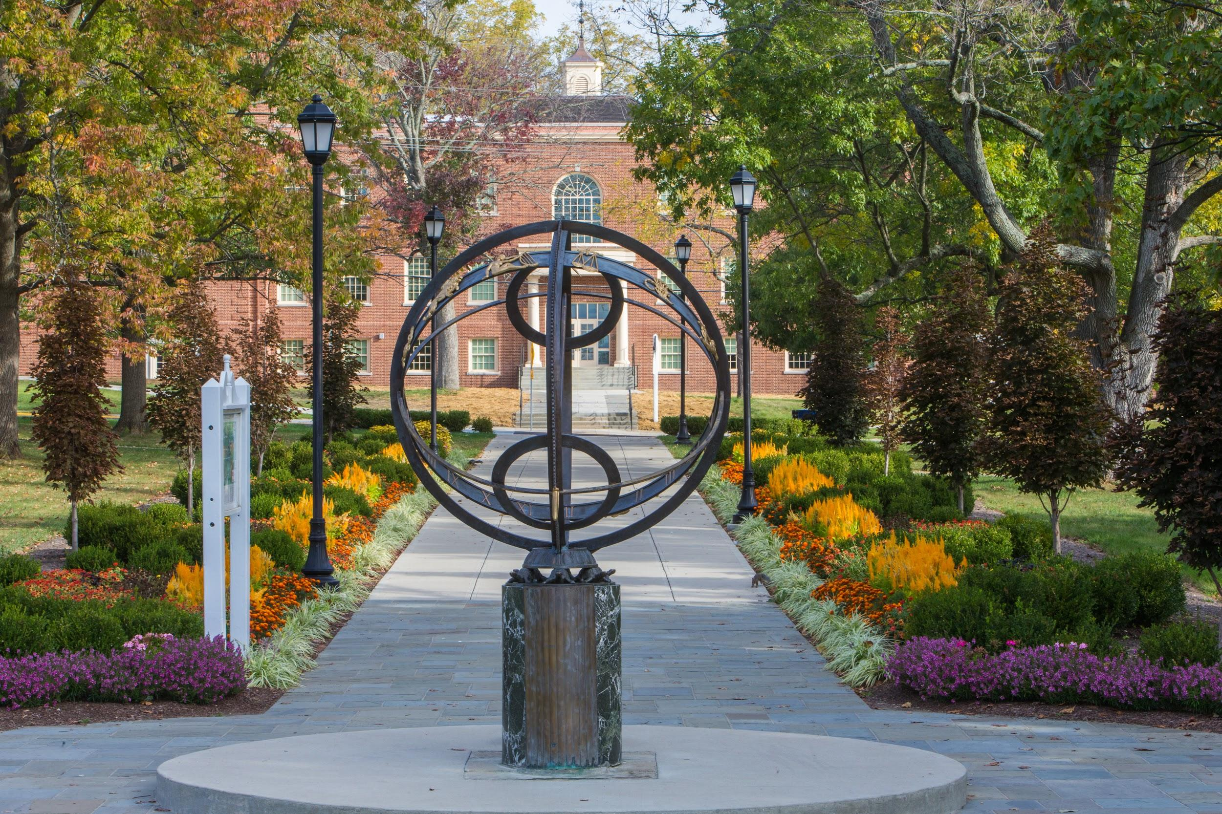
Agenda
Our Time Together
Explanation of Pillar via the President’s Charge
Subcommittee’s Interpretation and Discussions
Preview of Recommendations
Opportunity for Audience Engagement
Notes:
Spencer - Hi and thank you for attending our Structural and Resource Support TownHall.
Review Agenda (NEXT SLIDE)

Slide 3
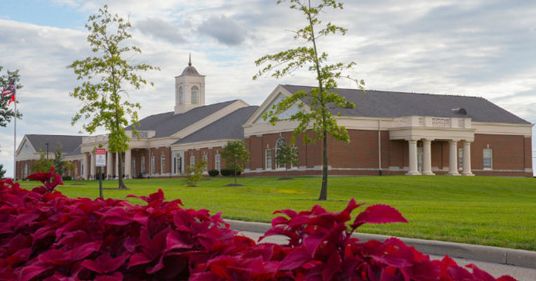
Structural & Resource Support - Sub Committee Members
Kyndal Fletcher - Student, Contributor
fletchka@miamioh.edu
Frank Huang - College of Creative Arts
huangfd@miamioh.edu
Spencer Izor (Subcommittee Chair) - University Advancement
izorsk@miamioh.edu
Stephen Lippman - College of Arts and Science
lippmas@miamioh.edu
Krista McDonald - Regional, Libraries
mcdonak@miamioh.edu
April Robles - Enrollment Management and Student Success
roblesad@miamioh.edu
Mark Sidebottom - College of Engineering and Computing sidebom@miamioh.edu
Notes:
Spencer - Intro of the committee - Thank you to each and every one of you and all of the time and effort you put into our recommendations. I look forward to our next steps together. hand off to April (NEXT SLIDE)

Slide 4
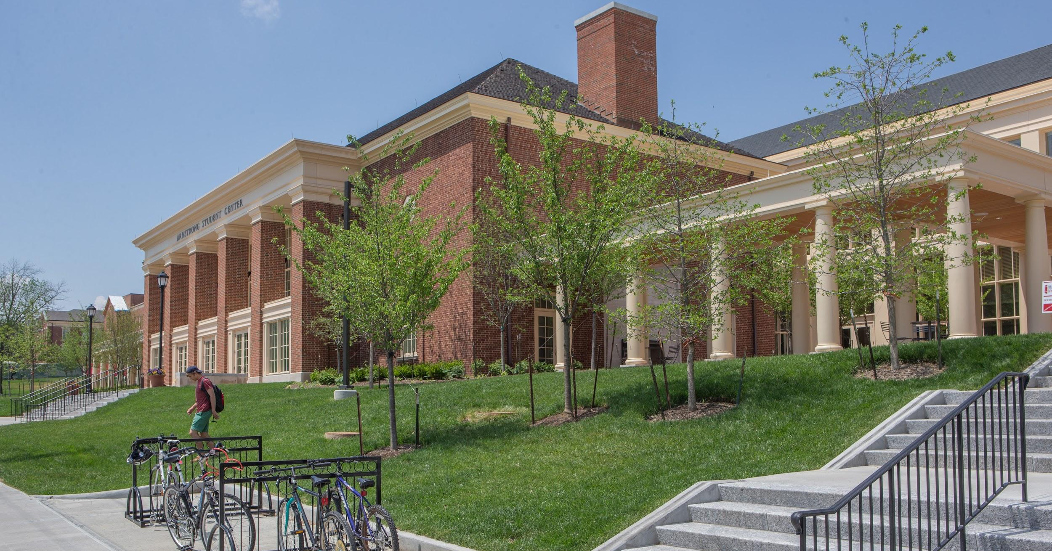
Structural & Resource Support - Our Charge
How can we re-envision our university structure to enable effective coordination of our DEI efforts?
We acknowledge that not all our efforts in diversity and inclusion have worked. We will add, adapt, and advance with fresh ideas and a commitment to become as diverse, equitable and inclusive as we can be.
What policies and procedures need to be examined that result in disparate outcomes?
Notes:
April - Our first meeting as a subcommittee was on June 22. If I had to summarize the approach of our committee it would be grounded in Action, Innovation and Making Hard Choices.
-> Our first question to answer answer as a committee - How can we re-envision our university structure to enable effective coordination for our DEI efforts?
I am going to quote directly from our charge - [from the charge] Nearly every academic and administrative division at Miami has devoted energy and resources to improving diversity and inclusion on campus. There has been success in many areas with events, programs, curriculum and extracurriculars developed by the students, faculty and staff. However, we as a campus have not effectively coordinated all those efforts. That lack of coordination can create gaps or duplication in our efforts and keep us from learning from each other and utilizing our resources effectively.
Our committee recognizes that while the work of diversity, equity and inclusion needs to be done and done with consistency across the board, we recognize the need for components of DEI to be permanently and explicitly a part of key administrative, faculty, staff and student paid positions, responsibilities and structures.
→ The second question we wanted to answer as a committee - What policies and procedures need to be examined that result in disparate outcomes?
We agreed that there are some policies and procedures that hinder our ability to truly service and support minority and/or under represented groups and other personal identities. We also agreed that some policies and procedures were developed either without diversity at the table or the perspective of diversity at the top of mind.
One part of our charge includes bringing attention to the external peer institutions and affiliated organizations with whom we have relationships is also in the charge, we will get to this, but have initially focused internally. (NEXT SLIDE)

Slide 5
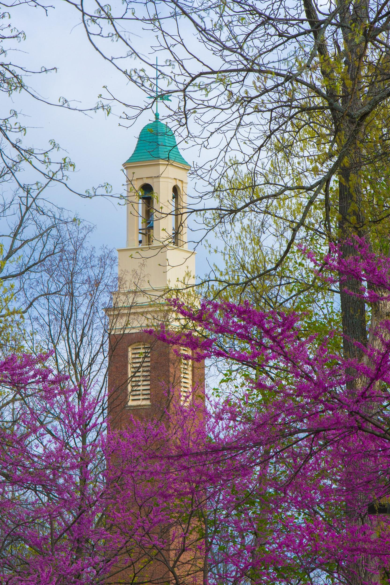
Structural & Resource Support - Informing Our Work
Generating ideas on our take of Structural & Resource Support
Gaining an understanding of the structures that exists within the university
Review Policies and Procedures
Review of Peer Institutions
50 institutions - public and private
examined structure, unique programs and initiatives
Notes:
April
Coming from various areas of the university we had many ideas and perspectives to share as group,
we created a significant list of ideas, we tried to gain an understand of the structures that exists within the university, we discussed policies and procedures, and we gathered information from a review of peer institutions where we highlighted the structures, unique programs and initiatives.
(NEXT SLIDE)

Slide 6
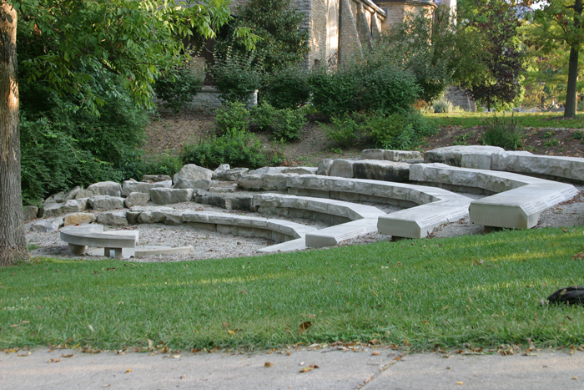
Preview of Recommendations
Restructuring
Office of Institutional Diversity
Addition of Senior Director of Diversity and Inclusion
Office of General Counsel
Addition of Civil Rights/Title IX Attorney
Divisions/Colleges
Addition of Diversity & Inclusion Communications Specialist
Examining Policies and Procedures
Naming Rights
Scholarships/Giving
University Calendar/Holiday Celebrations
Notes:
Spencer
Thank you April
I just want to preface our recommendations by mentioning that we realize the enormity of this task and that what we are proposing is this is just the tip of the iceberg. We hope that our Miami community will provide us with meaningful feedback and suggestions and know that while these are our initial recommendations we feel strongly that, if implemented, have potential to bring about real change to the culture of our University.
As you can see we have several recommendations as it relates to restructuring and the examination of current policies and procedures. For example, our subcommittee proposes the restructuring of our office of Institutional Diversity, the office of General Counsel, and our Divisions and Colleges. In addition and while there are additional policies that we would like to take a look at, we have started our examination with naming rights, scholarships and giving, and reviewing our current university calendar the holidays that the University is currently recognizing and/or celebrating. (Next Slide)

Slide 7
Miami University Current DEI Model
Notes:
We will start by taking a look at our current DE&I model at Miami University. I won’t go into great detail and read every position or group, but would like to highlight that we currently have one full-time staff member in the Office of Institutional Diversity. This is not to say that only there is only one person that is doing this important work but as far as our organizational structure is concerned and/or presented, it does appear that we have more than one formal position in this office. As you can see, the office of Equity and Equal Opportunity and the Council on Diversity and Inclusion report to our VP of Institutional Diversity. In OEEO, we have 5 staff members that are devoted to this important compliance work at our university but the nature of their work tends to be just that. Compliance. Also, many of you may be familiar with the CODI. This council has 29 members that representing many but not all areas of our campus. This council is advisory in nature and also meets with and reports to the VP of Institutional Diversity. On the other side of our slide you can see just a few of the examples of other, DEI efforts that are happening in and around the university. While vital to our culture, it does not appear that there is a formal organizational or reporting structure to unite all of these effort around an overall all vision and mission of the Office of Institutional Diversity. (NEXT SLIDE)

Slide 8
Miami University Structure
Notes:
Now let’s take a look at Miami’s Divisional Structure. Many of us are familiar with this so I don’t want to take a lot of time going through this but wanted to provide a visual so we all had a foundation of our current structure as it relates to Diversity, Equity, and inclusion. (NEXT SLIDE)

Slide 9
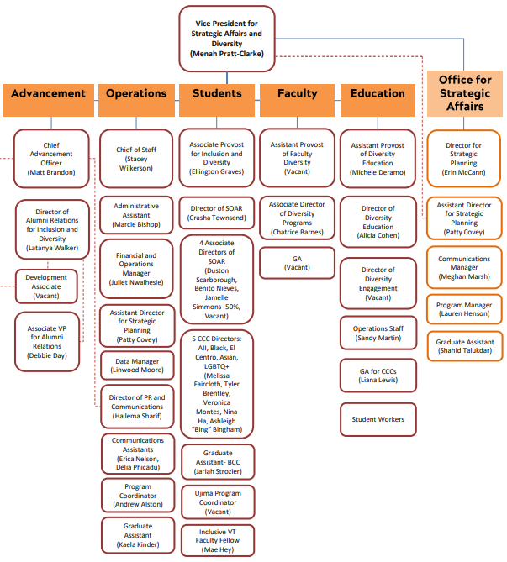
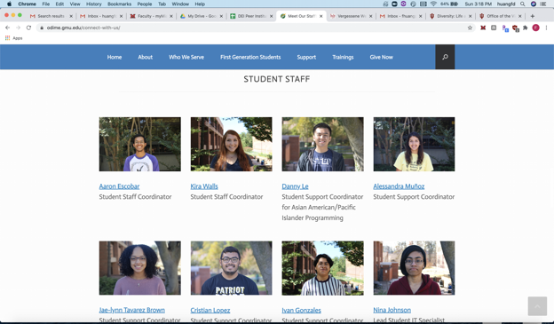
Preview of Recommendations Restructuring - Office of Institutional Diversity
Senior Director of Institutional Diversity
Diversity Specialist(s)
Student Ambassadors
Example from Virginia Tech University
Robust connectivity throughout the university structure
Example from George Mason University
International Student involvement as a part of the staff
Notes:
Spencer
Our first recommendation focuses on the restructuring of our Office of Institutional Diversity. Our subcommittee recommendation in this area, includes the addition of a Senior Director of Institutional Diversity position, the identification of “Diversity Specialists”, and the addition of student ambassadors/staff. Here are a couple of examples that we would like to share with you that came as a result of our Diversity and Inclusion Peer Institution Review.
The connectivity that Virginia Tech’s DE&I organization structure provided was very impressive as well as the student involvement that we found at George Mason University. At Virginia Tech you can see the robust staffing and as I mentioned connectivity/reporting structure. And at George Mason the international students function as members of the staff in the office of Diversity and Inclusion. Some of you may see similarities in some of the positions and resources we currently have at Miami and please know we value and appreciate all of those efforts. However, our recommendation hopes to further streamline and connect all of these efforts as well as add additional resources. (NEXT SLIDE)

Slide 10
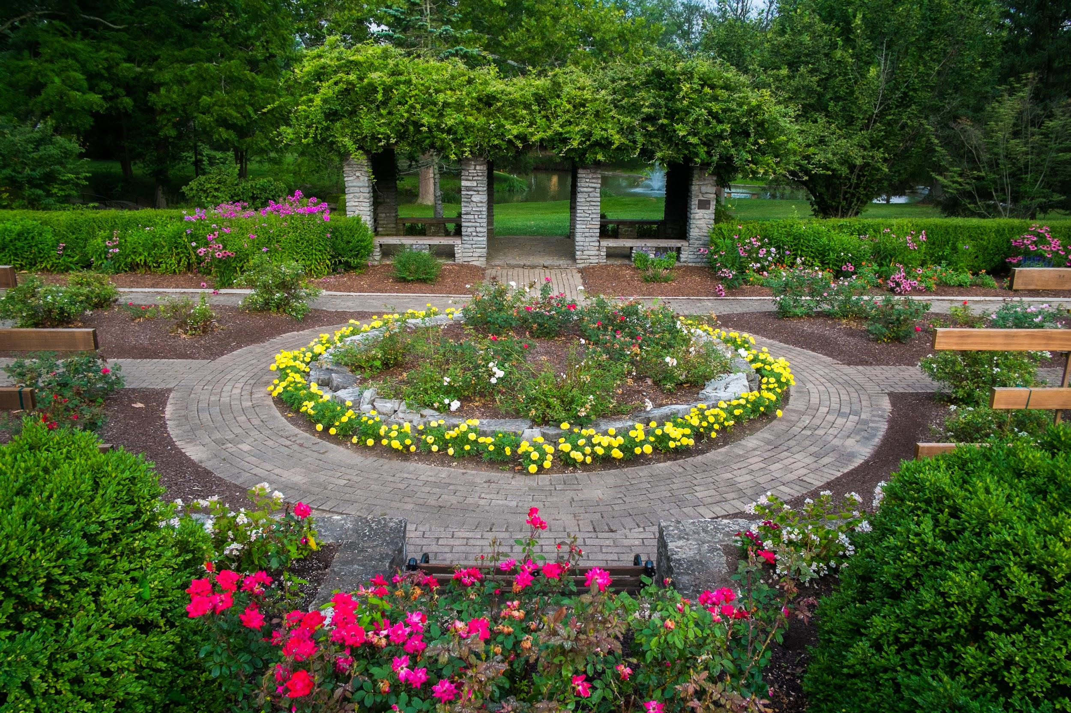
Preview of Recommendations Restructuring - Office of General Counsel
Associate General Counsel for Civil Rights and Title IX
Recommended responsibilities include but not limited to:
Ensures University policies and procedures are being followed, and that the University's policies, procedures are more closely aligned with our values, best practice in higher education, and the law.
Provide guidance, training, and work with other campus departments to advocate and promote nondiscrimination, equal opportunity, affirmative action, diversity and inclusion, etc.
Notes:
Spencer
Our second recommendation proposes a restructuring to the Office of General Counsel with the addition of an Associate General Counsel for Civil Rights and Title IX. While the job responsibilities of this position include much more than is listed on this slide we would like to highlight a couple of them. First, we recommend that this position focus to ensure university policies and procedures are more closely aligned with best practice in higher education and most importantly, the law.

Slide 11
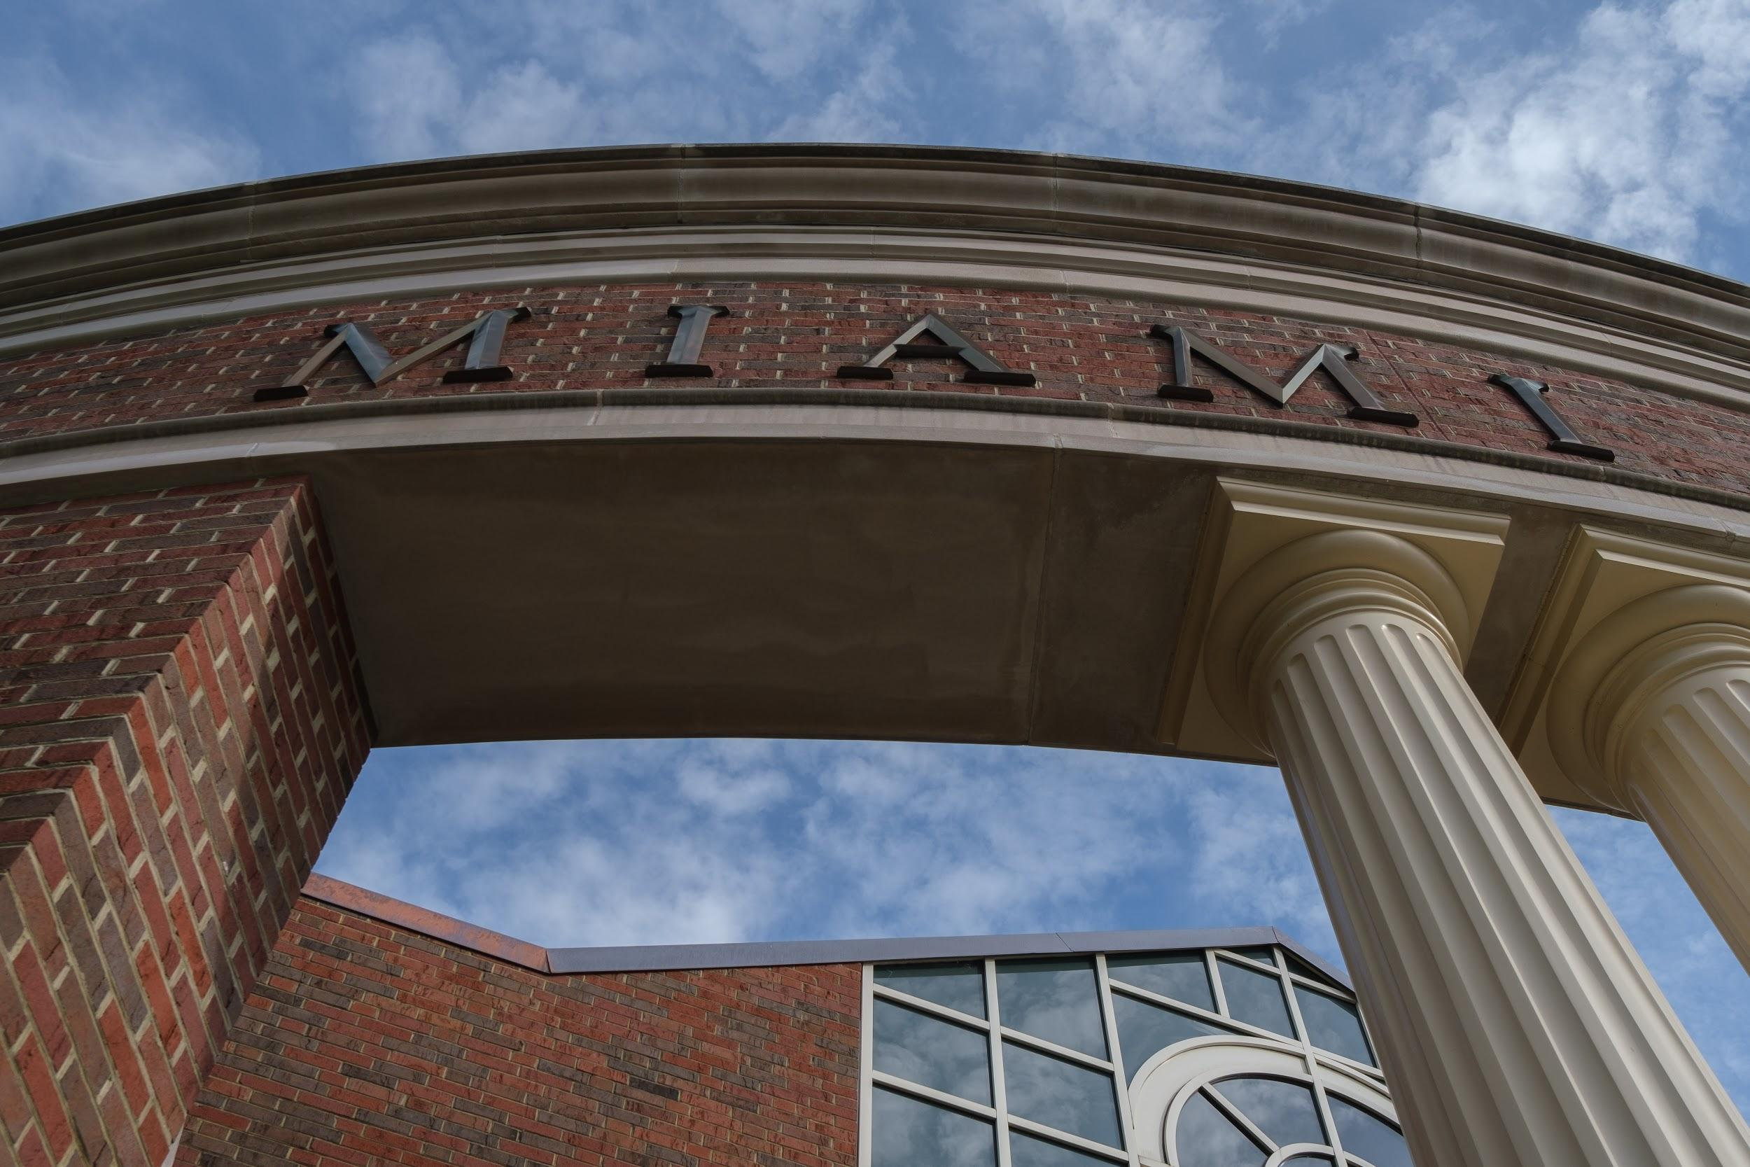
Preview of Recommendations Restructuring - Divisions and Colleges
Diversity and Inclusion Communications Manager
Divisional Diversity Specialists
Student Ambassadors
Notes:
Spencer
Our recommendation to restructure our Divisions and Colleges includes the addition of a Diversity and Inclusion Communications manager, Divisional Diversity Specialists and Student Ambassadors. The DE&I Communications manager will work with the wider university to develop and implement a communication plan that outlines how and via what channels the DEI efforts will be communicated. In addition, we recommend the identification of already existing faculty and staff members within each division who would be formally trained and have added job responsibilities to represent their divisions efforts in DE&I. For example, if April were to be chosen to be the Diversity Specialist for the EMSS Division her job title would now become “Director of Operations and Communications for the Center of Career Exploration and Success/Diversity Specialist” (Yikes what a mouthful! You may need to get a bigger business card April) But anyway, our recommendation would include not only additional job title and responsibilities but also compensation for doing so. The Diversity Specialist would then also included and listed as a part of the Office of Institutional Diversity staff as well as on the staff of where their current position resdies in the organizational structure. Finally, we propose that student positions be added to the Office of Institutional Diversity

Slide 12
Miami University Structure Part 2
Notes:
So let’s just quickly revisit Miami’s current overall organizational structure and then plug in and see our committees recommendations. (NEXT SLIDE)

Slide 13
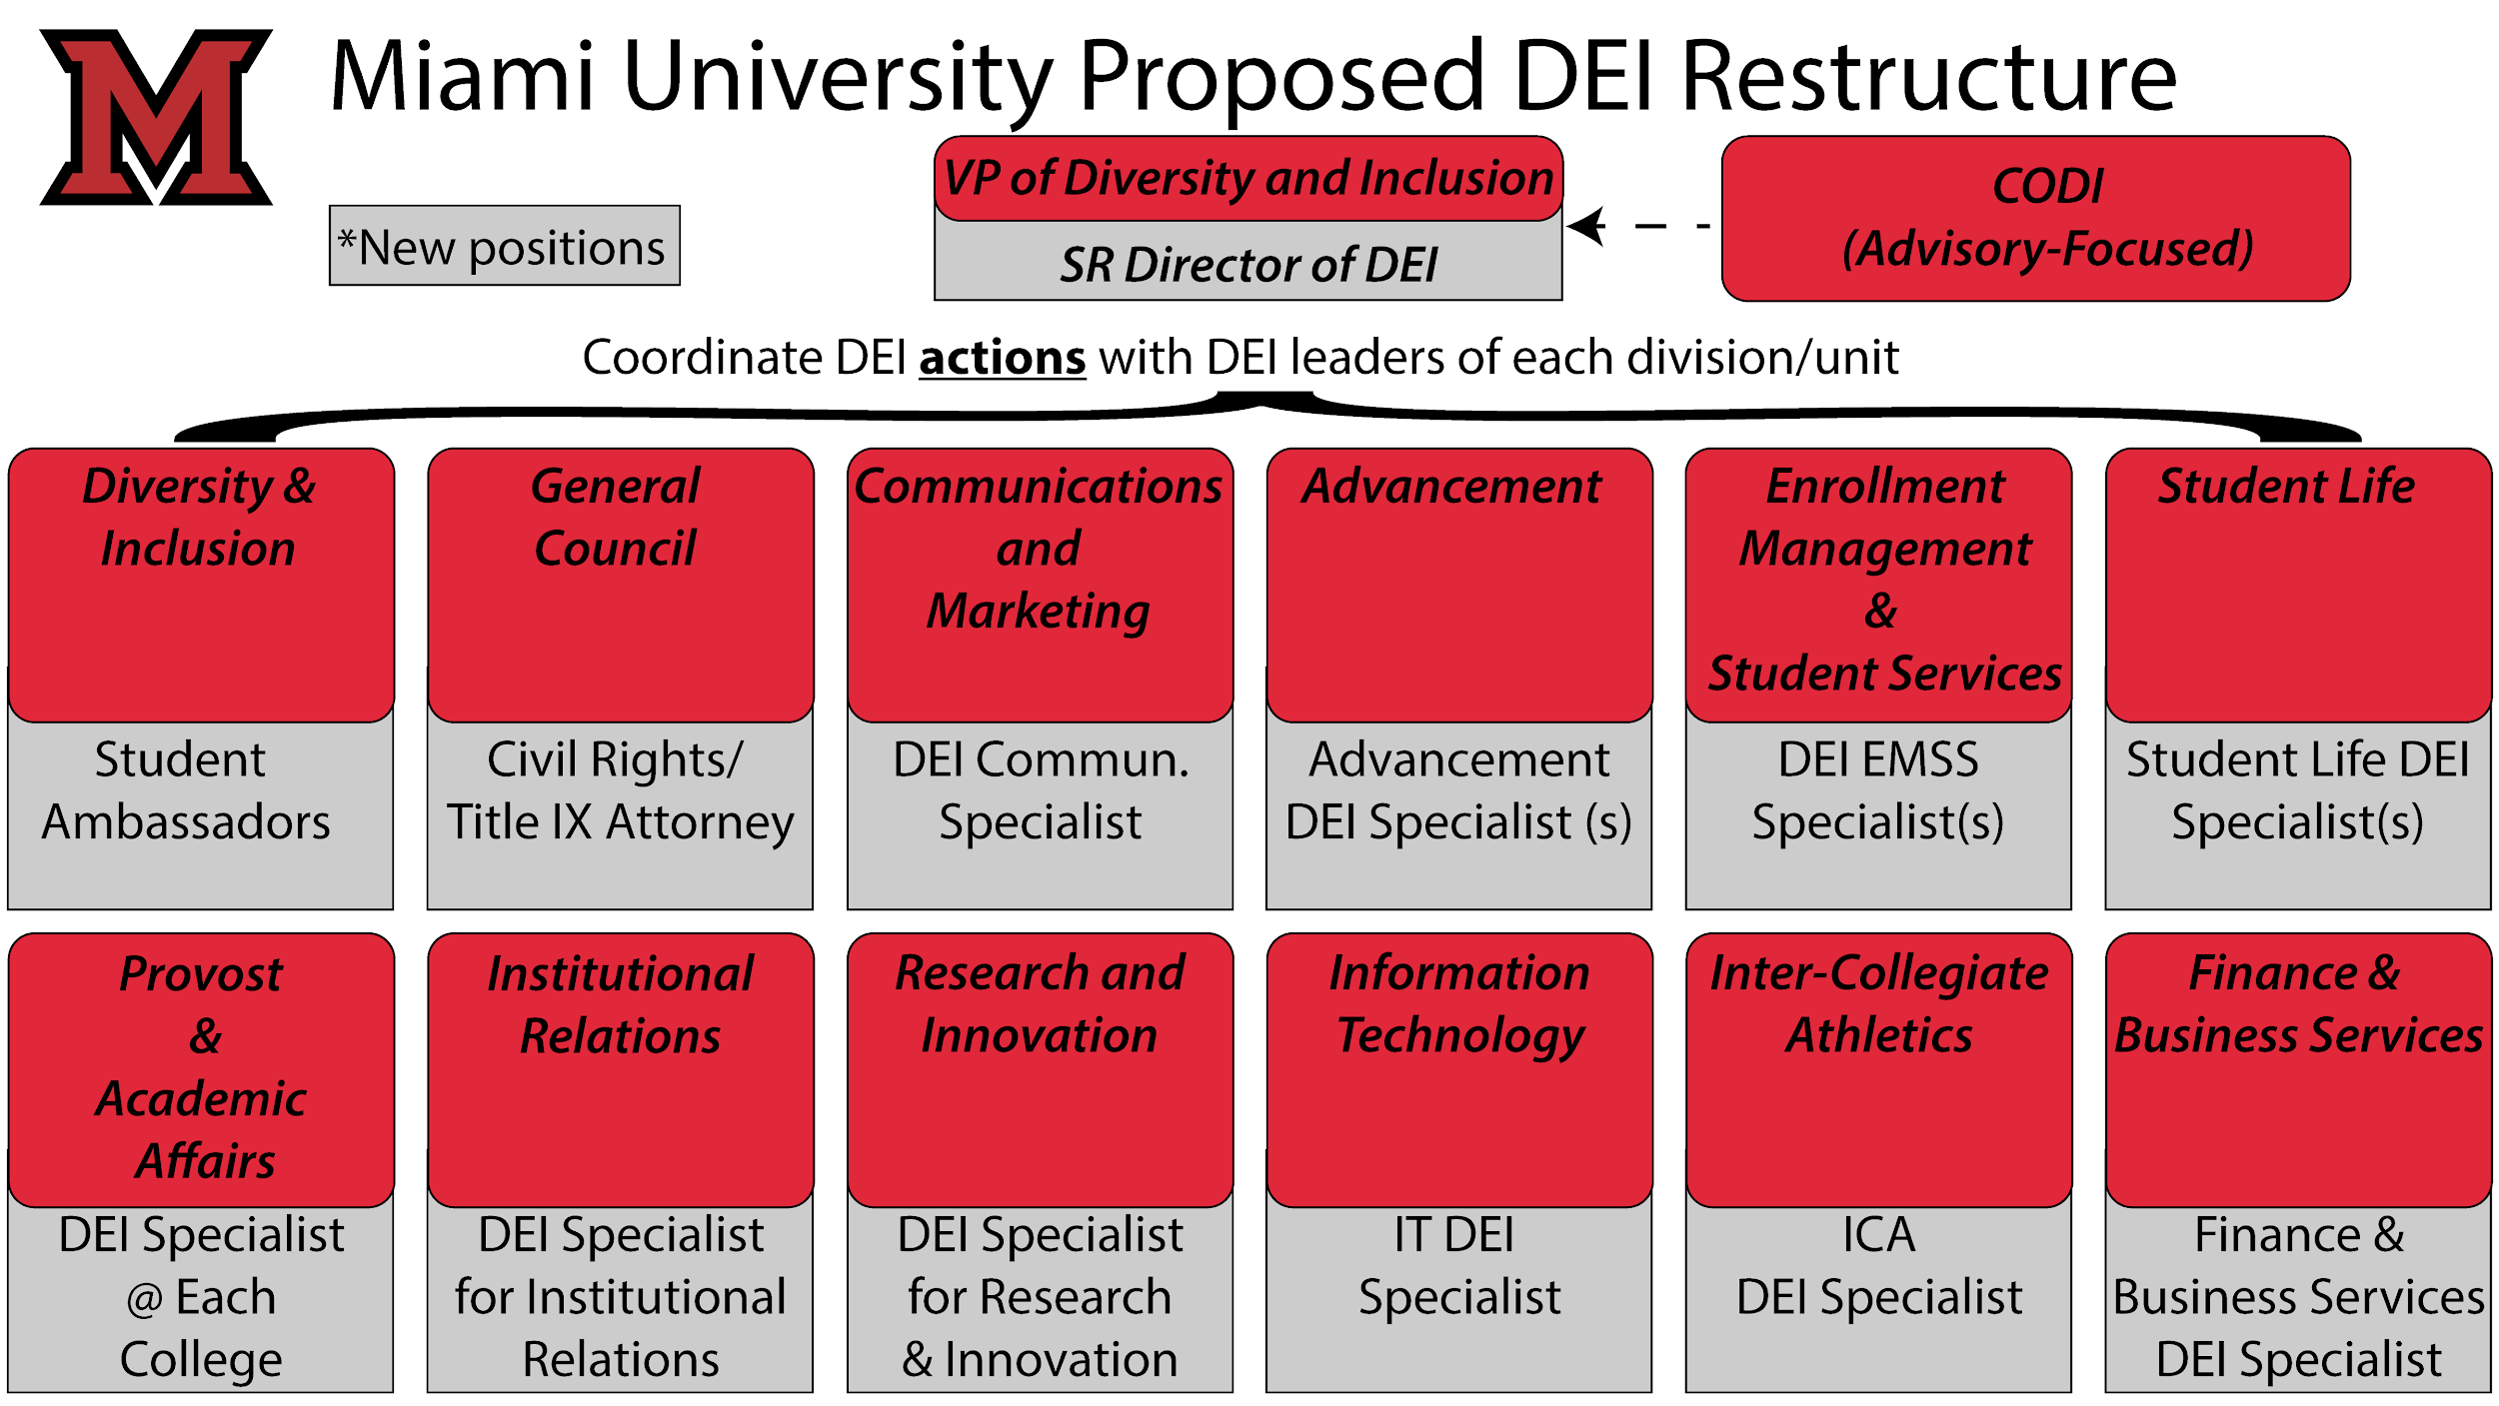
Miami University Proposed DEI Restructure
Notes:
Now let’s take a look at our proposed restructuring of the Office of Institution. You can see our new additions highlighted in grey. (Briefly run through new positions again.)
Now April is going to talk to us about our recommendations as it relates to policy and procedures. (NEXT SLIDE)

Slide 14
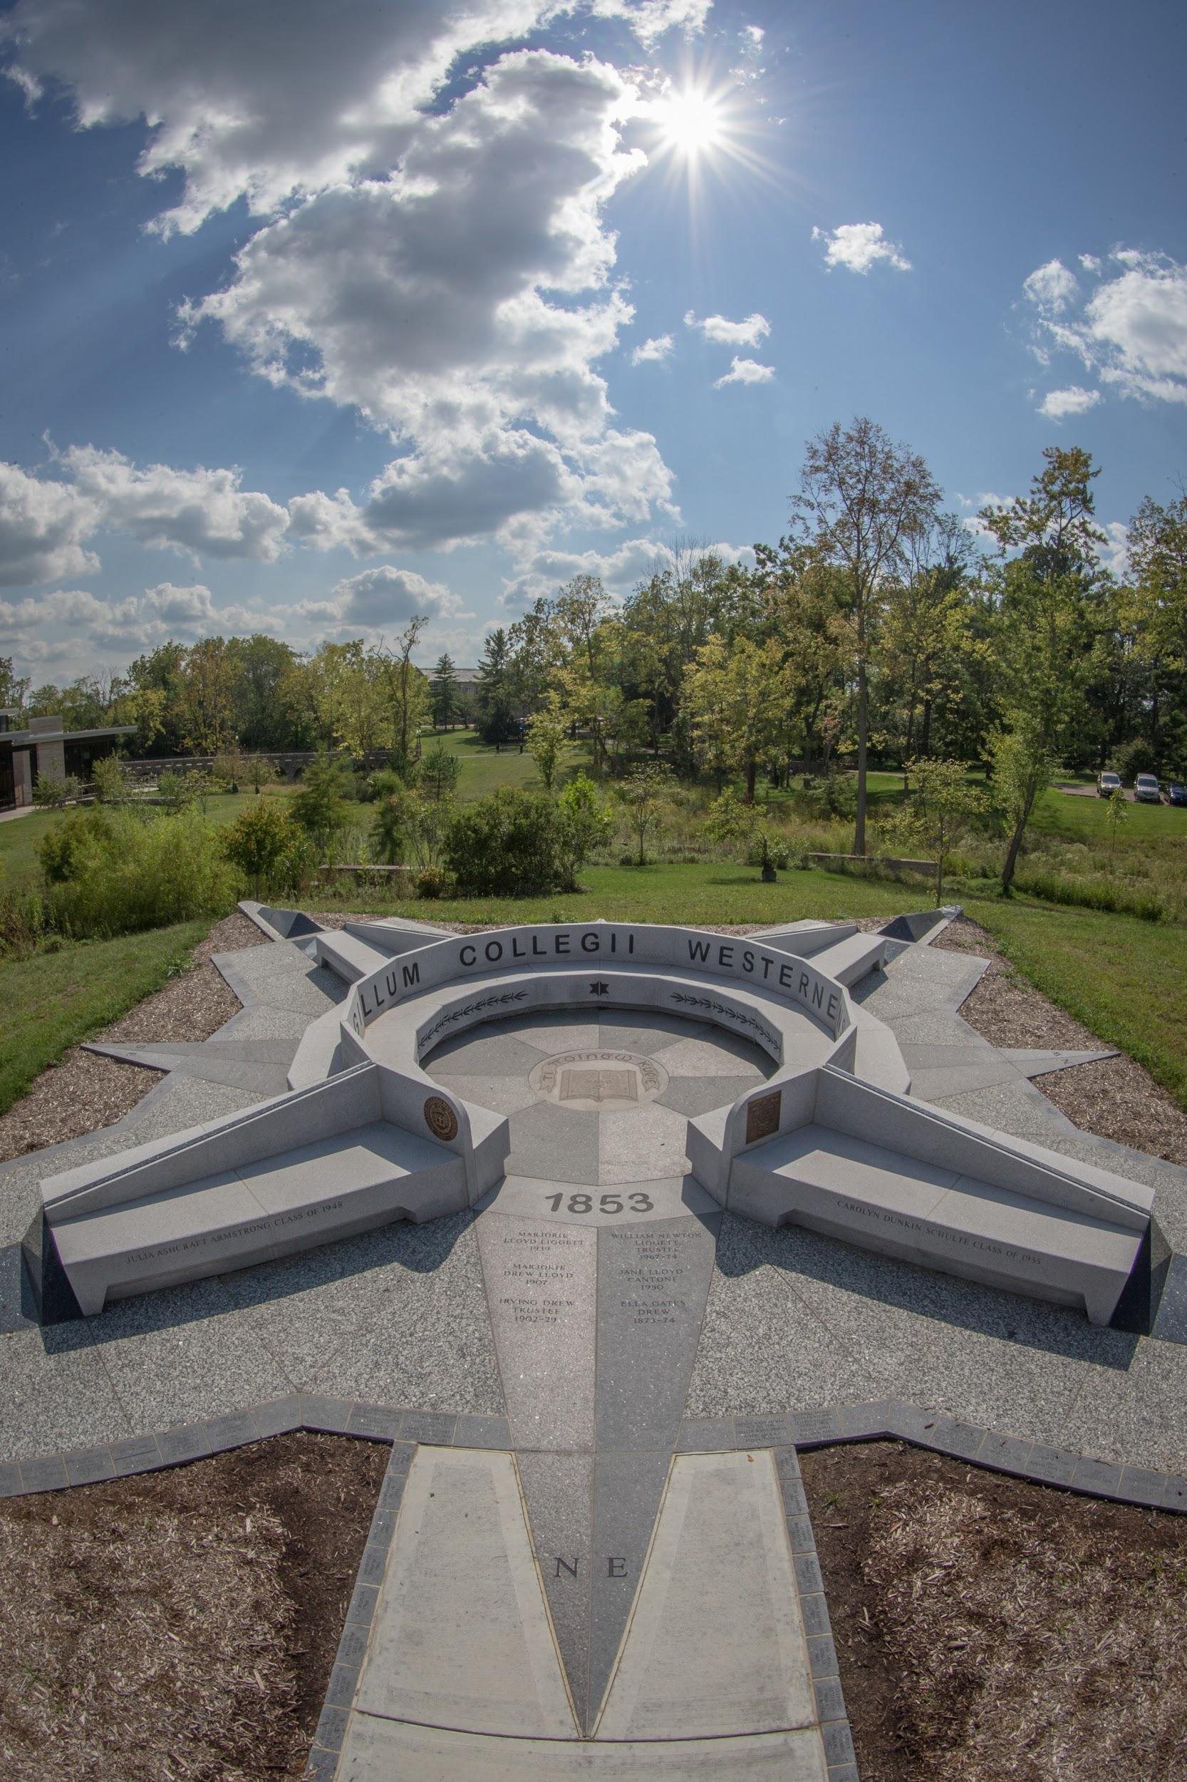
Preview of Recommendations Examining Policies and Procedures
Naming Rights
Scholarships
ACT/SAT
University Calendar/Holiday Celebration
Notes:
April
In general we needs to invest in our future.
Naming Rights
* We currently do not have any buildings named after minority and/or under represented groups. The University has a policy in place that allows for a wider scope of naming. That policy is not utilized in the way that it can be - to bring to light the accomplishments of an individual, not just because they have donated financially.
*While there are many Recommendations that can be made, we’d like to recommend that Nellie Craig, Miami’s first African American student, be recognized with a building named in their honor.
Scholarships :
*Our committee believes that attracting and retaining minority and/or underrepresented student populations can be influenced by the financial aid packages that can be awarded. Currently, we cannot designate scholarships to be awarded to specific minority and/or underrepresented student populations. The current wording is:
Preference shall be given to students of historically underrepresented populations in order to support the educational diversity at the University consistent with the University’s mission and admissions policy.* The Donor desires that larger scholarships be awarded to fewer students. The University may modify or disregard any selection criteria if it is determined, in whole or in part, to be contrary to the law.
* Our committee recommends that it be permissible for scholarships to specify minority and/or underrepresented student populations in the criteria for endowing and awarding the scholarships. We appreciate the gifts that the university receives, but we feel that it is important to go beyond preferences.
The US Department of Education 1994 Guidance determined that postsecondary institutions may use race in a narrowly tailored way to award financial aid to achieve a compelling interest in diversity.4 In 2003, the Supreme Court upheld the view that diversity is a compelling interest. The rationales relied on in Grutter v. Bollinger5 to uphold a compelling diversity interest, as did the rationales relied on by Justice Powell in Regents of the University of California v. Bakke, apply to institutions that use race and national origin in awarding financial aid to seek the benefits of diversity This remains current as advice and law.
ACT/SAT
*While currently the university has suspended the requirement of the ACT/SAT for the next incoming class, we’d like to examine and recommend the complete suspension of the ACT/SAT requirement. There are studies that show that there are racial and economic bias with these test scores.
University Calendar/Holiday Celebration
*We recognize that there are constraints with being a public institution and requirements as our holiday .
*We recommend a close examination of the holidays that are supported, recognized and acknowledged to be thoroughly reviewed. We appreciate the university recognizing Juneteenth and believe that the observance of this and other holidays should be planned in a way that shows how we as an institution value those holidays and the people who observe them.
Our sub-committee will continue to examine Exclusionary policies and procedures as move forward. Spencer will now go through the questions that were submitted prior to our presentation and then we will plan to move into the questions that have been submitted during the presentation. (NEXT SLIDE)

Slide 15
Opportunity for Audience Engagement
Q & A
Notes:
Thank you April and again thank you to all of you for attending and for your questions and feedback. We really appreciate it and take every suggestion seriously. Let’s go ahead and jump in to some of these questions.
Who has power on campus and why? - Well I believe power exists in a lot of different places. We are obviously a hierarchical institution but we have a shared governance model with a University Senate, a president, a student government.
How does Miami plan to equip students with the resources that they will need to educate themselves from day one? What support systems are there for our students of color - the previous task force recommended and the university implemented a first year class as well as discussions during orientation.
How does the university plan to protect our students of color? Our current structure makes it difficult from a resource perspective to protect and provide for all of the needs of students of color but we hope that our recommendations of of structural support will provide additional protections outside of the those already provided by law.
"How can we undo the damage that was done by the RCM model? Without context to the damage that is being referred to here. I do know that with that with any model that is around for 8 years, unfortunately, certain habits are created during extended periods of time. I'm sure, during times of financial crisis, this model or any budgetary model forces the hand of many of our university leaders to make difficult decisions that negatively impact diversity and inclusion efforts. Since the university has implemented a new model, and in the absence of a global pandic positive change should be expected. However, I would say that any of the reductions that have been made currently or in the past were not done so in a manner that would purposefully undermine these efforts. All of that being said, our subcommittee and Presidential Task force as a whole, does recommend a commitment and further investment in the financial resources afforded to diversity and inclusion efforts.
How can we find "value" and not be obsessed with data driven decisions? Data is an extremely important part of making informed decisions but the narrative our stories and shared experiences can only amplify what the data is telling us. Data and values should not be mutually exclusive.
What structures will create a community that mentors others? This is a great question and mentoring is a vital part of DE&I efforts. Stay tuned for more information from tomorrow's committee on this particular subject.
How can we create a structure that values community partnership? Community Partnerships is actually a part of the chargeof this subcommittee and what we will be examing and sharing with the larger community very soon.
Do we have a description of our current state for structural and resource support at MU? Asked and Answered in presentation
Ok, do we have any more time for questions from the chat.

